Slide 1
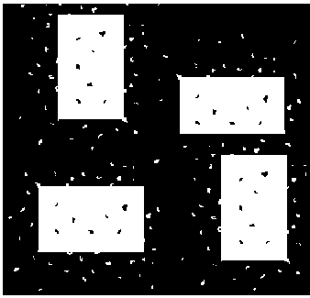


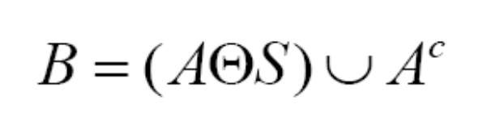

Question 1
4 points
30 – 11 - 2010
Quiz#4
Describe an algorithm to find the size of large boxes in the image below:
Question 2
6 points
Consider the following binary image A:
Show the result of applying the following on image A with a 3x3 structuring element S
Just show how the image will look like.
No need to perform any calculations.
Indicate clearly which part is white and which is black
NO CREDIT for intermediate calculations. I will only check the final output.

